Slide 1
^{Bolt:} On-Demand Infinite Loop Escape in Unmodified Binaries
Michael Kling$, Sasa Misailovic, Michael Carbin, and Martin Rinard
Massachusetts Institute of Technology
$Jane Street
Notes:
Today I’m going to talk about Bolt, a tool that we’ve been building in the group to detect and escape infinite loops in unmodified binaries.
----- Meeting Notes (10/17/12 17:01) -----
Change to dollar bill

Slide 2
^{Bolt:} On-Demand Infinite Loop Escape in Unmodified Binaries
Michael Kling*, Sasa Misailovic, Michael Carbin, and Martin Rinard
Massachusetts Institute of Technology
Jane Street*
Notes:
Today I’m going to talk about Bolt, a tool that we’ve been building in the group to detect and escape infinite loops in unmodified binaries.
----- Meeting Notes (10/17/12 17:01) -----
Change to dollar bill

Slide 3
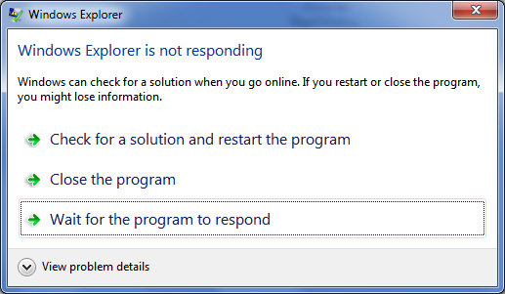
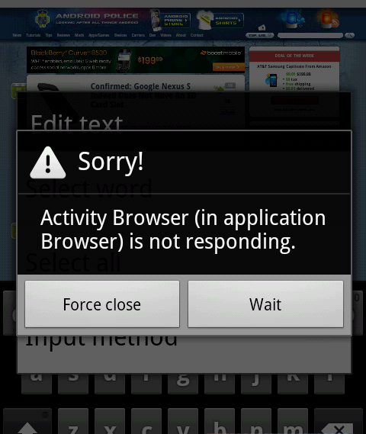
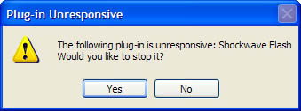
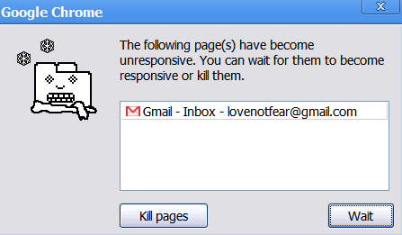
^{Bolt:} On-Demand Infinite Loop Escape in Unmodified Binaries
Michael Kling*, Sasa Misailovic, Michael Carbin, and Martin Rinard
Massachusetts Institute of Technology
Jane Street*
Notes:
Today I’m going to talk about Bolt, a tool that we’ve been building in the group to detect and escape infinite loops in unmodified binaries.
----- Meeting Notes (10/17/12 17:01) -----
Change to dollar bill

Slide 4
B lt
Coerce program to continue executing.
Program produces output. You don’t lose work
Automatically detects and escapes infinite loops

Slide 5
Basic Approach
1. If application unresponsive, launch Bolt
Bolt
Bolt attaches via dynamic binary instrumentation

Slide 6
Basic Approach
2. Bolt detects if application is in infinite loop
Bolt determines if application is executing a loop
Bolt takes snapshots of each loop iteration
If two snapshots are the same, infinite loop!

Slide 7
Basic Approach
3. Bolt offers user option to escape loop
Bolt transfers application’s execution out of loop
Return from function (optionally set return value)
Jump to different instruction (instruction after loop)

Slide 8
Basic Approach
4. Bolt lets user to explore multiple strategies
Bolt checkpoints the application and filesystem
Bolt executes each strategy
User selects output that best suits their needs

Slide 9
Bolt’s Key Property
On Demand
No special compilation No overhead unless Bolt is attached

Slide 10
Wireshark 1.4
GUI hangs when parsing Zigbee ZCL Packets
Parsing module calls dissect_zcl with tree = NULL
1: void dissect_zcl(Tree *tree) {
2: //…init…
3: while (i < ZBEE_ZCL) {
4: if (tree) {
5: // …process…
6: i++;
7: }
8: }
9: // …
10: }
tree | NULL
i | 0
tree | NULL
i | 0
Notes:
1. Take snapshots at each loop iteration

Slide 11
How does Bolt work?

Slide 12
Step 1: Identify if Application is Executing in a Loop
1: void dissect_zcl(Tree *tree) {
2: //…init…
3: while (i < ZBEE_ZCL) {
4: if (tree) {
5: // …process…
6: i++;
7: }
8: }
9: //…
10: }
0x368: test %al,%al
0x36a: je 0x3df
0x36c: nopl 0x0(%rax)
0x370: test %rbx,%rbx
0x373: je 0x370
0x37c: mov $0x3,%ecx
0x381: mov %rbp,%rsi
0x384: mov %rbx,%rdi
0x387: xor %eax,%eax
Notes:
This loop looks rather silly, but it is the result of optimization. Not clear what the compiler should do with infinite loops as it may be the intended behavior of the program. I think its only in the C++0x standard now that infinite loops have undefined behavior.
Looks silly, but is the result of optimization. Loop unswitching
Ctcl-c (this should be ctrl-alt-delete) strictly speaking
Gcc with optimizations turned on sees that the exit condition is not being changed is tree is NULL. So, loop immediately returns to the top.

Slide 13
Loop Detection Algorithm
Objective: find repeating sequence of instructions
Those executed in the highest stack frame
Challenge: where is the highest stack frame?
On demand means possibly no frame pointer
Solution: substitute frame pointer with calling context
Notes:
zSelect pivot instruction (instruction in any frame)
Rexecute pivot in same stack frame

Slide 14
Calling Context Reconstruction
Intuition
Observe execution trace
Matched returns are new procedure calls
Unmatched returns are part of calling context
At ret instruction, top of stack is the return address
call
…
call
…
call
…
ret
…
call
…
ret
…
ret
…
ret

Slide 15
Calling Context Reconstruction
Intuition
Observe execution trace
Matched calls and returns are new procedure calls
Unmatched returns identify calls in calling context
At ret instruction, top of stack is the return address
call
…
call
…
call
…
ret
…
call
…
ret
…
ret
…
ret
Context
Attach Point
Matched
Unmatched

Slide 16
Step 2: Detect Infinite Loop
Snapshot each loop iteration
Save only modified state
If two snapshots are the same, then infinite loop
i
state
snapshots
1
2
3
4
Notes:
On the right you see that the states repeat after three iterations

Slide 17
Step 3: Identify Escape Strategies
Strategy 1: return from function (optionally set return value)
Strategy 2: jump to instruction after loop
1: void dissect_zcl(Tree *tree) {
2: //…init…
3: while (i < ZBEE_ZCL) {
4: if (tree) {
5: // …process…
6: i++;
7: }
8: }
9: //…
10: }
0x368: test %al,%al
0x36a: je 0x3df
0x36c: nopl 0x0(%rax)
0x370: test %rbx,%rbx
0x373: je 0x370
0x37c: mov $0x3,%ecx
0x381: mov %rbp,%rsi
0x384: mov %rbx,%rdi
0x387: xor %eax,%eax
Notes:
Looks silly, but is the result of optimization. Loop unswitching
Ctcl-c (this should be ctrl-alt-delete) strictly speaking
Gcc with optimizations turned on sees that the exit condition is not being changed is tree is NULL. So, loop immediately returns to the top.
----- Meeting Notes (10/17/12 17:01) -----
Mike

Slide 18
Step 4: Search for Escape
ctrl+c
checkpoint
user
User chooses what works for them
Notes:
Total size of the search space in evaluation. Break (1 possibility), Unwind with -1, 0, 1, and whatever is in return register

Slide 19
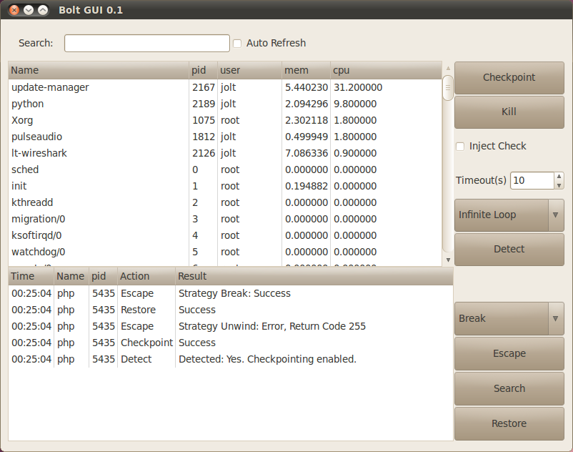
Implementation
Supporting tools
Pin
ptrace
Libunwind
Berkeley Lab Checkpoint/Restart
Bolt’s GUI and analyses run on x86/x64 Linux

Slide 20
How does Bolt work?
well

Slide 21
Benchmarks: 13 Loops
Methodology
Acquired loops and inputs from bug reports Evaluated every loop we could reproduce
13 Infinite Loops in 10 apps (GUI, console, server):
PHP, Wireshark, Apache, PAM, ctags (2 loops), grep (3 loops), ping, indent, look, Java VM
Notes:
Note that we didn’t do any selection of infinite loops.
Methodology:
What timeout did we use?
10 seconds of execution time our 10^5 analyzed instructions.

Slide 22
Can Detection Be Done Efficiently?
Bolt detects 11 of the 13 infinite loops
9 repeat state after one iteration PHP after 4 iterations and PAM after nondeterministic
Loop detection times are less than 6 s
Memory for snapshots < 1 KB (per iteration)
Other 2 loops do not repeat state within10 s timeout
indent and Java VM
Notes:
This is not the actual slide, just the narrative we would like to have in here.
Total number of iterations
Total Memory consumption for successfully detected loops.
Php, per iteration = 128 + 688
Pam, per iteration = 192 + 0
Php iterations = 4
Pam iterations = ?
----- Meeting Notes (10/19/12 17:40) -----
attach to the process pin

Slide 23
How Good is Output After Escape?
Methodology
Applied Bolt to escape from all 13 loops
Compared outputs to Ctrl+C
Compared outputs to developer-fixed version
Better outputs than Ctrl+C for 11 of 13 loops
Enables applications to resume processing input
Semantic changes are isolated to single components
Escape exactly matches developer fix for 7 of 13 loops
Exiting loop is often the right thing to do in a corner case
Ctrl+C on indent deletes all your source code
Notes:
This is not the actual slide, just the narrative we would like to have in here.
Comparison of two escape strategies:
Escaping the loop is better for 4 loops
Escaping the function is better for 7 loops
Both same for 3 loops
----- Meeting Notes (10/17/12 17:35) -----
switch order
continues to output productively
compare with popper.

Slide 24
Why do Infinite Loops Happen to Good People?
Missing Transitions
Encounters unexpected input and there’s no available action
Loop just cannot make progress
Incorrect Exit Condition/Action
Incorrectly check if loop reached end of input
Fail to exit loop when finished
Notes:
Long Running Computation
Malformed input file field (poppler) or inefficient algorithm (gawk)
----- Meeting Notes (10/17/12 17:35) -----
isolated
fsa to illustrate
state, unwind to go back and then jump to processing.

Slide 25
Python Ctags Infinite Loop
Objective: find triple quotes in string (ctags)
static void find_triple_end (char const *string)
{
char const *s = string;
while (1) {
s = strstr (string, TRIPLE_QUOTE);
if (!s) break;
s += 3;
// ...
}
}
Beginning of line
Should be s

Slide 26
Why do Infinite Loops Happen to Good People?
Missing Transitions
Encounters unexpected input and there’s no available action
Loop just cannot make progress
Incorrect Exit Condition/Action
Incorrectly check if loop reached end of input
Fail to exit loop when finished
Notes:
Long Running Computation
Malformed input file field (poppler) or inefficient algorithm (gawk)
----- Meeting Notes (10/17/12 17:35) -----
isolated
fsa to illustrate
state, unwind to go back and then jump to processing.

Slide 27
PAM Infinite Loop
Objective: copy input to bounded length temporary buffer
while (*orig) { /* while there is still some input to deal with */
// ... if ((strlen(tmp) + 1) < MAX_ENV) {
tmp[strlen(tmp)] = *orig++;
} else {
/* is it really a good idea to try to log this? */
D(("Variable buffer overflow: <%s> + <%s>", tmp, tmpptr));
pam_syslog("Variable buffer overflow: \ <%s> + <%s>",tmp, tmpptr);
}
// ... }
Actual comment
Missing return

Slide 28
Related Work
Infinite Loop Escape
Jolt (Carbin, et al., ECOOP ‘11) requires instrumentation
Bounding Loop Length
Detecting and Eliminating Memory Leaks Using Cyclic Memory Allocation (Nguyen and Rinard, ISMM ‘07)
Non-termination Provers
TNT (Gupta, et al., POPL ‘08) using Invariant Generation
Looper (Burnim, et al., ASE ‘09) using Symbolic Execution
Termination Provers
Terminator (Cook, et al., PLDI ‘06)

Slide 29
Conclusion
Infinite loops can be detected
Escape is often better than termination

Slide 30
Takeaway
Notes:
This doesn’t have to be the only option for dealing with unresponsive programs. Instead we can use techniques like bolt to exploit the natural resiliency of an application, to make it give us the answer that we want.

Slide 31
The End
From: "Armando Solar-Lezama" <asolar@csail.mit.edu>
To: "Martin Rinard" <rinard@csail.mit.edu>
Subject: Thanks
I was writing a document in Word this morning, and after about an hour of unsaved work, Word went into an infinite loop that made the application completely frozen.
So, having listened to your talks too many times, I got my debugger, paused the program, changed the program counter to a point a few instructions past the end of the loop, and let it keep running from there.
Word went back to working as if nothing had ever happened. I was able to finish my document, save it, and close Word without problems.
So thanks,
Armando.

Slide 32
Backup Slides

Slide 33
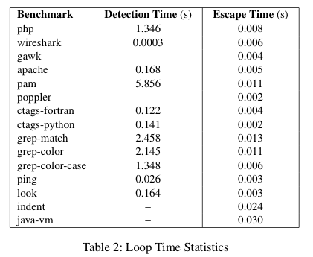

Slide 34
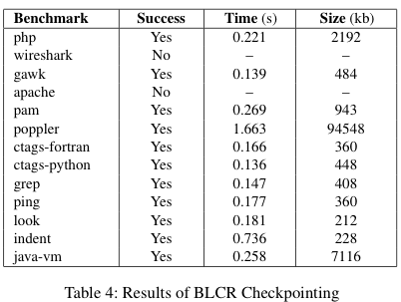

Slide 35
