Slide 2
PPSM Registry
Agenda
View the computer based training video
Supplemental training slides with Subject Matter Experts
Q&A forum with Subject Matter Experts
Audio via teleconference/DCS audio (Dial-in not needed if using DCS audio)
410-874-6300
312-874-6300 (DSN)
Access Code: 818848092

Slide 3
PPSM Registry

Slide 4
PPSM Supplemental Slides

Slide 5
Ports, Protocols, and Services Management (PPSM)
How do I receive an account?
Fill out a DD2875 and sign it, then have your supervisor and security officer sign it
Send Completed DD2875 to your Organizations PPSM Office, DoD PPSM does not create accounts for users other then PPS representatives
Your PPS Representatives will create your account and provide your roles within the PPSM Registry
DoD Contact List

Slide 6
Ports, Protocols, and Services Management (PPSM)
Further Information when Registering
When Registering, DoD PPSM is moving away from Mission Assurance Category (MAC) to RMF Level: Confidentiality, Integrity, and Availability both are located on the Bulk Upload Spreadsheet and the PPSM Registry
When Registering DoD PPSM is only looking for the Listening port, which are already listed on Vulnerability Reports within the Category Assurance List and within the PPSM Registry when you select a specific service
When inputting IP addresses, they are not a requirement unless when the service is crossing boundaries 1 and 2 unless directed to do so by your PPSM Office
There are two Registries: One on NIPR (PPSM-U) and one on SIPR (PPSM-C)
PPSM-U is the repository for all unclassified PPSM Registrations
PPSM-C is the repository for all classified PPSM Registrations
There are still unclassified registrations on PPSM-C however they are not editable

Slide 7
Question & Answer Session
Questions?
Answers!
Information
Exchange

Slide 8
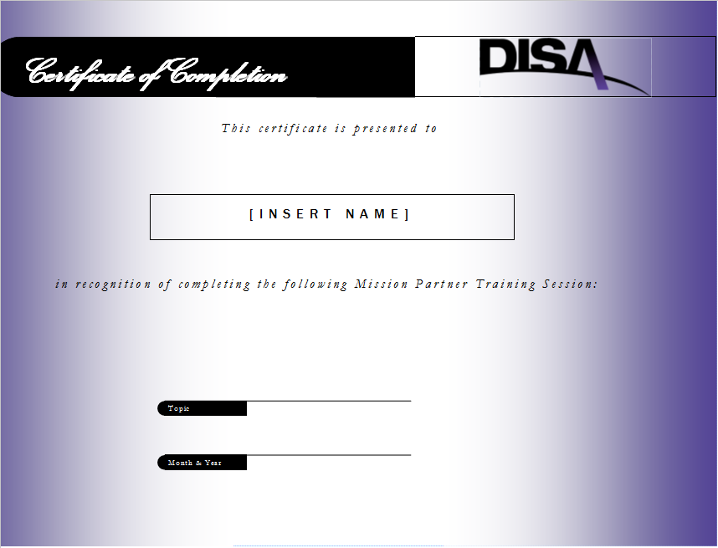
Contact Information
Mission Partner Training Program
CBT Location:
https://cyber.mil/connect/mptp
Contact Information
301-225-4330 (Commercial), 312-375-4300 (DSN)
disa.meade.re.mbx.mptp@mail.mil

