Slide 2
PPSM Overview
Agenda
View the computer based training video
Supplemental training slides with Subject Matter Experts
Q&A forum with Subject Matter Experts
Audio via teleconference/DCS audio (Dial-in not needed if using DCS audio)
410-874-6300
312-874-6300 (DSN)
Access Code: 818848092

Slide 3
PPSM Overview

Slide 4
PPSM Supplemental Slides

Slide 5
Ports, Protocols, and Services Management (PPSM)
Topic Overview:
Further Action (FA)
What is a Further Action?
Who submits the completed form? What happens after the completed form is submitted?
Component Local Service Assessment (CLSA)
What is a Component Local Service Assessment
Who submits the completed form? What happens after the completed form is submitted?
Exception Requests
What is an Exception Request?
Who submits the completed form? What happens after the completed form is submitted?
Temporary/Emergency Requests
What is the difference between a standard exception request and a temporary/emergency request?
Who submits the completed form? What happens after the completed form is submitted?
Quick Links
Who are the CCB/TAG representatives? How do I find their contact information?
Where can I find more information on the PPSM program?
Where are the Drop Boxes?

Slide 6
Further Action (FA)
Further Action (FA)
Used to add a new data service to the PPSM Category Assurance List (CAL) when the data service traverses boundaries external to the component enclave (1-8 and/or 15)
The component TAG representative will QC and submit the completed FA template to the DoD PPSM FA Dropbox for processing
Once complete, vulnerability assessments for new services are presented at the CCB/TAG meeting
A technical POC may be requested to join the meeting
The board will critique the report and approve it for e-vote as-is, or recommend changes
After e-vote, the data service will be placed on the CAL and any component may register against the newly established standard
FA Process Guide | FA Template

Slide 7
Component Local Service Assessment (CLSA)
Component Local Service Assessment (CLSA)
Used to add a new data service to the PPSM Category Assurance List (CAL) when the data service traverses internal boundaries (9-14 and/or 16)
The component TAG representative will QC and submit the completed CLSA template to the DoD PPSM CLSA Dropbox for processing
CLSAs are not presented at the CCB/TAG meeting
Only the component that submitted the CLSA may register against that service
Typically, if multiple components register the same local service, the VA team will write a Local Service VA report, retire the individual CLSA submissions, and establish a standard report for all components to register against.
CLSA Process Guide | CLSA Template

Slide 8
Exception Request (Standard)
Exception Request (Standard)
Used to request a non-standard usage of an established standard
Data service must be listed on the DoD Category Assurance List
All requests must be received 5 business days before the CCB/TAG meeting
Standard exception requests do not need to be signed by the AO/AODR
The component TAG representative will QC and submit the completed Exception template to the DoD PPSM Exception Dropbox for processing
Once received, the request will be presented by the requestor at the upcoming CCB/TAG meeting
After e-vote, if approved, the exception is granted for 6 months or until the ATD date, whichever is earlier
If necessary, standard exceptions can be extended by re-presenting to the CCB/TAG before the exception expires
Exception Process Guide | Exception Template

Slide 9
Exception Request (Temporary/Emergency)
Exception Request (Temporary/Emergency)
Used to request emergency use of a new data service or non-standard use of an existing data service.
All temporary/emergency requests must meet one of the following four (4) criteria:
Failure to implement the temporary request will have major operational impact or directly prevent the execution of an operational Commander’s mission
Failure to implement the temporary request will significantly impact, degrade or isolate a portion of the DoDIN
Failure to implement the temporary request will potentially cause loss of life, limb, or cause a mission critical asset to incur significant loss of money
Failure to implement the temporary request will impact any General/Flag Officer and/or directly a principle customer (POTUS, SECDEF, CJCS/JCS, COCOM CC/HQ and or Service Chief),where no alternate capability exist.
Temporary/Emergency exception requests MUST be signed by the AO/AODR
The TAG representative will QC and submit the completed template to the DoD PPSM Exception Dropbox for processing
Once received, the DoD PPSM Chair may approve/deny the request
Exception Process Guide | Exception Template

Slide 10
Component POCs
Quick Links
Resource | Link
DoD PPSM SharePoint Homepage | https://disa.deps.mil/org/RE4/RE42/PPSM/default.aspx
PPSM NIPR Registry | https://pnp.cert.mil/pnp
PPSM SIPR Registry | https://pnp.cert.smil.mil/pnp
FA Dropbox | https://disa.deps.mil/org/RE4/RE42/PPSM/External/Technical%20Advisory%20Group/Further%20Actions/DROP-BOX
CLSA Dropbox | https://disa.deps.mil/org/RE4/RE42/PPSM/External/Technical%20Advisory%20Group/CLSA/DROP-BOX
Exception Dropbox | https://disa.deps.mil/org/RE4/RE42/PPSM/External/Technical%20Advisory%20Group/Exception%20Management/Exception%20Drop%20Box
Component Contact List | https://disa.deps.mil/org/RE4/RE42/PPSM/DoD%20Component%20Contact%20List

Slide 11
Question & Answer Session
PPSM Overview
Questions?
Answers!
Information
Exchange

Slide 12
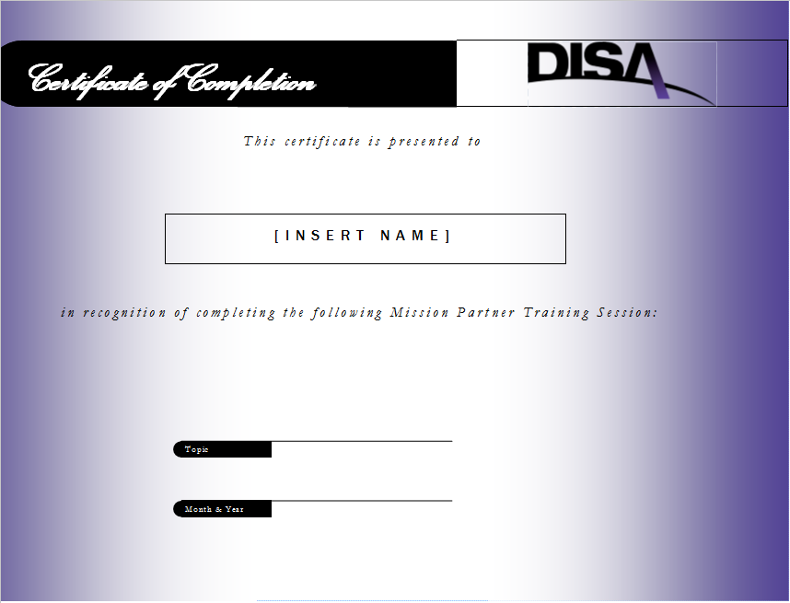
Contact Information
Mission Partner Training Program
CBT Location:
https://cyber.mil/connect/mptp
Contact Information
301-225-4330 (Commercial), 312-375-4300 (DSN)
disa.meade.re.mbx.mptp@mail.mil

